Slide 1
Market trends and outlook
OPENAP 2026 - Keynote
June 2026

Slide 2
Thank you for inviting Rotate to Marrakech!
Excluding perishables, Morrocco is one of the largest cargo markets in Africa
African air cargo tonnage by export market, 2025
Thousand tonnes, 2025
Non-perishables
Perishables
65
28
21
18
15
13
12
South Africa
Morocco
Kenya
Uganda
Nigeria
Tunisia
Ghana
Ethiopia
Source: Rotate Air Demand data, Rotate analysis (June 2026)

Slide 3
Agenda
State of the industry
Middle East capacity impact
Trends (demand) beyond the ME

Slide 4
Global demand & capacity grew 30 months in a row before the ME conflict
Air cargo demand and capacity growth
% YoY (measured in tonnes)
Demand
Capacity
Demand outgrew capacity during most of these months
Since 2024, demand growth has exceeded capacity growth
(CAGR ‘23-’25: 10% vs 6%)
Last 2 months demand data, based on Xeneta actuals
2022
2023
2024
2025
2026
Note: International air cargo demand and capacity only, capacity by freighters and widebody passenger aircraft only (including integrators and charter flights)
Source: Rotate Live Capacity; Rotate Air demand; IATA monthly statistics, Rotate analysis (June 2026)
What does it mean??

Slide 5
This global growth happened despite substantial market volatility
Key events impacting the air cargo market in 2025
“Fentanyl” tariffs on CN, MX, CA
1 February
”Reciprocal” tariffs announcement
13 February
US tariff “Liberation Day”
2 April
End of US
de minimis
2 May
90-day pause US tariffs ends/extended
8 Jul-1 Aug
SZX, HKG & MFM closures due to Typhoon Ragasa
23-25 September
B777X deliveries delayed to 2029
4 December
Trump hints at CN, MX, CA tariffs
November 2024
Valentine’s
day
14 February
Labor Day¹ and Golden week
29 Apr-5 May
50% EU tariffs announced/delayed
23-25 May
90-day reprieve on US-China tariffs ends
11 August
US threatens 100% China tariffs
10 October
First Red Sea transit in 2 years
18 December
Jan
Feb
Mar
Apr
May
Jun
Jul
Aug
Sep
Oct
Nov
Dec
Trump takes
office
20 January
Chinese/Lunar
New Year
Early Feb
Iberian peninsula power outage
28 March
Change in EU de minimis
20 May
Red sea crisis intensifies
July
Tariff exemption on select EU goods³
1 September
US govt. shutdown
7-17 November
Supply impact
Demand impact
China tariffs increased to 20%
4 March
Mother’s Day²
(flower season)
11 May
Escalation of ME conflict
14 June
50% US tariffs on India
27 August
US-China deal, averting 100% tariffs
27 October
Crash & grounding of all MD11Fs
20 November
Note: 1) Not observed on May 1 by US, Canada, UK, Netherlands, Denmark, Finland, Australia among others; 2) May differ by country, generally observed in May; 3) Pharmaceuticals amongst others
What does it mean??
Notes:
Liberation day: https://en.wikipedia.org/wiki/Liberation_Day_tariffs; India –Pakistan: https://en.wikipedia.org/wiki/2025_India%E2%80%93Pakistan_crisis#:~:text=(Discuss),injured%20more%20than%2020%20others.
Mothers day: https://blog.officeholidays.com/general/when-is-mothers-day-around-the-world/
UK deal: https://www.whitehouse.gov/fact-sheets/2025/05/fact-sheet-u-s-uk-reach-historic-trade-deal/
https://en.wikipedia.org/wiki/2025_Iberian_Peninsula_blackout

Slide 6
ME conflict: the capacity recovery of Gulf airports has come a long way
Capacity recovery¹ from the Gulf Region², since 1 March
Capacity per Gulf airport, 26 May 2026
Index: average 2026 weekday² = 100%
Recovery³, %
Thousand tonnes
 |  | 70%
Gulf
18.1
Freighter (71%)
Previous week: 84%
WB passenger (66%)
Previous week: 78%
 | 70%
 | 70%
 | 56%
 | 106%
 | 94%
 | 51%
 | 64%
 | 137%
DOH
4.7
Temporary dip due to lower demand during Eid holidays.
DXB
3.6
DWC
2.3
AUH
2.1
RUH
1.7
JED
1.0
BAH
0.8
01/03
15/03
29/03
12/04
26/04
10/05
24/05
07/06
SHJ
0.5
Note: Figures include all freighters and widebody passenger flights only, analysis considers international sectors only; 1) Daily capacity recovery is based on a 3-day moving average centered around the actual day; 2) Gulf region including Bahrain, Iran, Iraq, Kuwait, Oman, Qatar, Saudi Arabia, United Arab Emirates; 3) Compared to the average capacity in week 2 to week 7 in 2026 (pre-CNY); Source: Rotate Live Capacity; Rotate analysis (May 2026)
What does it mean??

Slide 7
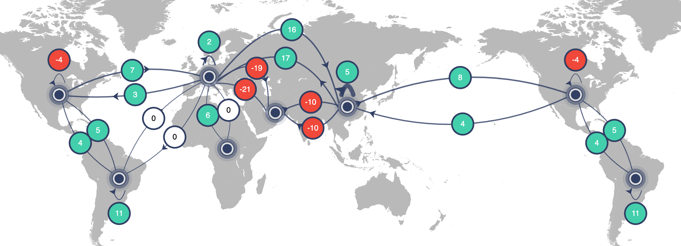
ME conflict: global capacity is at the same level as last year despite continuous disruptions
🔗 Link to the dashboard
Capacity¹ changes by trade lane, 29 May – 04 June 2026 vs. 2025
Differences in tonnes, %
Global capacity growth +1%
Used to be +6% before the conflict
Note: 1) International only, for all freighters and widebody passenger aircraft only
Source: Rotate Live Capacity; Rotate analysis (June 2026)
What does it mean??

Slide 8

Yield: global yields remain up +30% vs. last year, fuel prices up +116%
Jet fuel price and yield¹ development, Jan-May 11, 2026
Jet fuel price and yield development, 18-22 May 2026 vs. 2025²
Index (January 1st = 100)
YoY
Jet fuel price
+116%
Brent
+70%
22 May
20 Feb
Yield spot rate
+33%
1.7x
Yield (spot) changes per lane
Origin
Destination
YoY
Europe | Middle East
Asia Pacific | Middle East
Asia Pacific | Europe
Asia Pacific | North America
Europe | North America
1.3x
+97%
+51%
+34%
+27%
+19%
04 Jan
18 Jan
01 Feb
15 Feb
01 Mar
15 Mar
29 Mar
12 Apr
26 Apr
10 May
24 May
Note: 1) Jet fuel prices are reported daily, while yield spot rate data is reported weekly, 2) Week 18-22 May data was taken from IATA Jet fuel price monitor average for the week
Source: IATA Jet fuel price monitor, U.S. Gulf Coast Kerosene-Type Jet Fuel Spot Price (EIA); Argus U.S. Jet Fuel Index; Xeneta Weekly Market Update; Rotate analysis (May 2026)
Voice over fuel availability trends ?
What does it mean??

Slide 9
Demand: about half of this year’s demand growth is driven by tech
36% | 14% | 8% | 5% | 15% | 7% | 23% | 2% | 2% | - | -1% | - | 4%
Air cargo demand growth by industry, 2026 YTD¹
+7%
Jan’26-Mar’26
Thousand tonnes (%)
600
+36
+23
+37
+50
+83
Sustained strong
e-commerce growth is slowing down
266
+98
For large part driven by data center components
Technology
Raw Materials
Industrial
E-commerce
Chemicals
Consumer goods
Special category
Other
Health care
Perishables
Total Growth
Notes: 1) Year to date included January to March 2026, vs the same period last year
Source: Rotate Air Demand; Rotate Analysis (June 2026)
What does it mean??

Slide 10
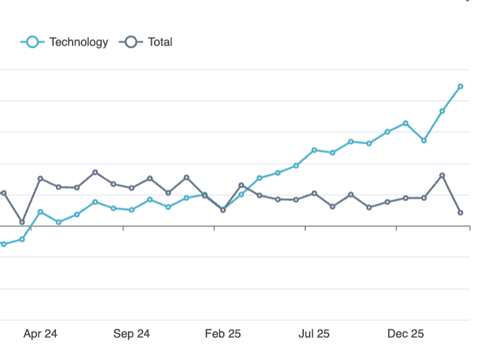
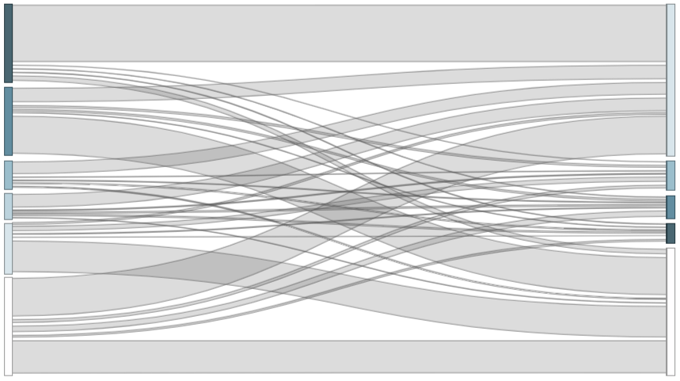



Cloud computing exports from Asia are growing exponentially
Observations & takeaway
Tripling of Taiwan exports saw it become the leading exporter of cloud computing demand
  China – the previous top-ranked exporter – shows relatively “modest” +28% growth
Vietnam and Thailand register significant growth, nearly entirely driven by USA flows
The US imports more than quadrupled, to now represent 50% of global imports
Imports into the Netherlands and other European markets grow at a much slower rate
Cloud computing¹ air demand, 2026 YTD²
Tonnes
7x growth, vs. already strong 2025
Taiwan
+390%
USA
+300%
China
+28%
Vietnam
+135%
Netherlands
+13%
Thailand
+400%
Singapore
+165%
USA
+18%
Japan
+18%
Other
+14%
Other
+31%
Notes: 1)Cloud computing equipment made up of cloud computing parts, non-8471 data processing units and communication apparatus for data transmission
2) Year to date included January to March 2026, vs the same period last year; Source: Rotate Air Demand, Rotate analysis (June 2026)
What does it mean??

Slide 11
Continued growth of Asia widenes imbalances on corridors
Development of air trade imbalance across key corridors
Thousand tonnes
Transpacific
Transatlantic
Europe-Asia
Ratio¹
2.5x
3.2x
Ratio
1.6x
1.7x
Ratio
1.6x
2.3x
273
516
N. America-Asia
N. America-Europe
264
Europe-Asia
480
Asia-N. America
454
1,171
Europe-N. America
414
Asia-Europe
763
Q4 2023
Q4 2025
Q4 2023
Q4 2025
Q4 2023
Q4 2025
Notes: 1) Ratio of demand in tonnes
Source: Rotate Air demand, Rotate Analysis (March 2026)
Write something about growth of EUR to N.America
What does it mean??

Slide 12
Reminder: 2025 growth figures vary between market sources – heavily influenced by e-commerce, ACMI/charters, and the unit of measure
Keep > as education?
Can rewrite the title a bit…
E-commerce capture
Carrier coverage
Unit of measure
Not accounting for e-commerce has
a 2 p.p. impact on growth figures
Fast-growing charter, ACMI and e-commerce carriers bring up global average growth figures by ~2 p.p.
Measuring capacity (and demand) in tonnes
or ATKs/FTKs will have a ~1 p.p. impact on growth rates
Air cargo demand growth, 2025 vs. 2024
%
International capacity growth¹, 2025 vs. 2024
% (measured in tonnes)
International capacity growth¹, 2025 vs. 2024
%
8.5%
In contrast, e-commerce has grown 20% and is 17% of total tonnes
In contrast, growth rate of excluded carriers is 32%
6.5%
5.9%
5.2%
5.2%
3.3%
With
e-commerce
Without
e-commerce
All airlines
Excl. charter/ ACMI/e-commerce²
Tonnes
ATKs³
Note: 1) Capacity analysis includes WB/NB freighters and WB passenger aircraft only; 2) Excluded airlines include (in order of absolute growth) Atlas, Kalitta, SF Airlines, MyFreighter, Central Airlines, National Airlines, Air Atlanta, China Central Airlines, Rom Cargo, One Air, Beijing Capital and 5 smaller carriers; 3) Flights between ANC and the USA counted as international; Source: Rotate Live Capacity; Rotate Air Demand; Rotate analysis (March 2026)

Slide 13
Rotate helps you make better commercial decisions
Software | Data | Consulting

Slide 14






















We are Rotate
Skip for presentation – but keep for distribution
Rotate helps key players across the global air cargo and logistics industry to improve results through better commercial and strategic decisions. We provide cloud-based software and analytics, world-leading market data, and data-driven strategy consulting
Our clients include top-tier airlines, airports, freight forwarders, governments, shippers, investors, and other industry stakeholders
Founded in 2022 by a core team of former Seabury aviation strategy consultants, Rotate has offices in the Netherlands and Malaysia. Our diverse team of 60+ professionals uniquely blends air cargo and strategy consulting expertise with software engineering
We build things that matter. We are passionate about air cargo and believe there is huge potential to turn data into action and create practical solutions and strategies that deliver results

Slide 15
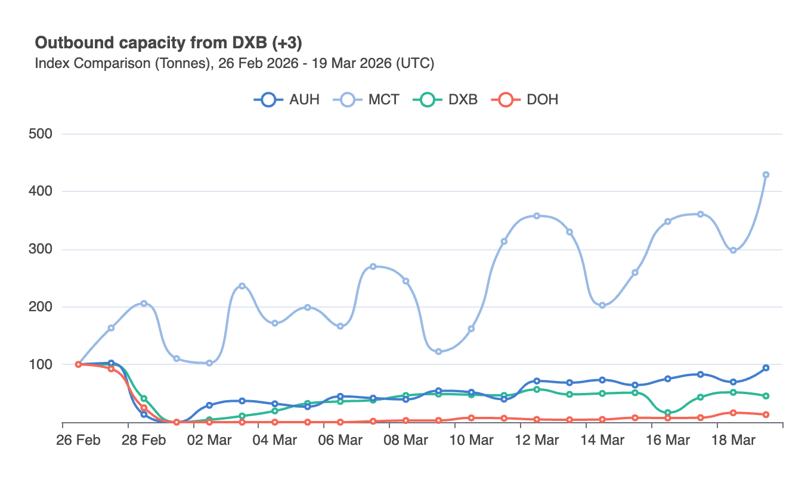
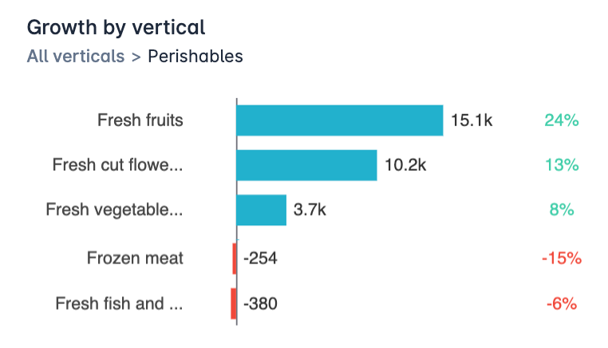
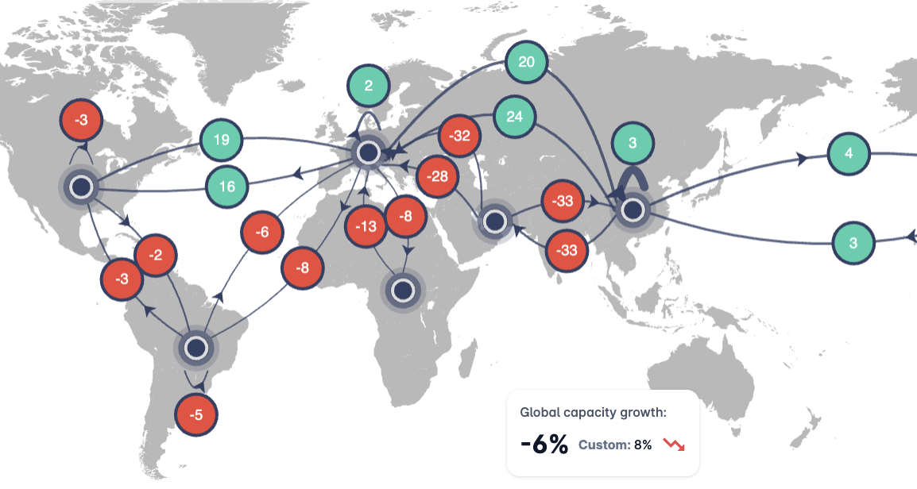
We provide high-quality market data to global forwarders and airlines
…Designed to quickly answer your commercial questions
Live Capacity data
Global air demand data
Intuitive user-interface
Real time capacity insights
Covering >99.9% of the world’s flights
Including indirect capacity and RFS
Future scheduled (WB belly) capacity
Working towards >99% global coverage
+5,000 individual commodities
Mapped to 12 air cargo-specific verticals
Reliable (China) e-commerce estimates
Dashboards for targeted use cases
Analysis Tool to easily browse datasets
AI-interface acting as your cargo analyst
API integration synching to your systems
Quarterly C-level market reports

Slide 16
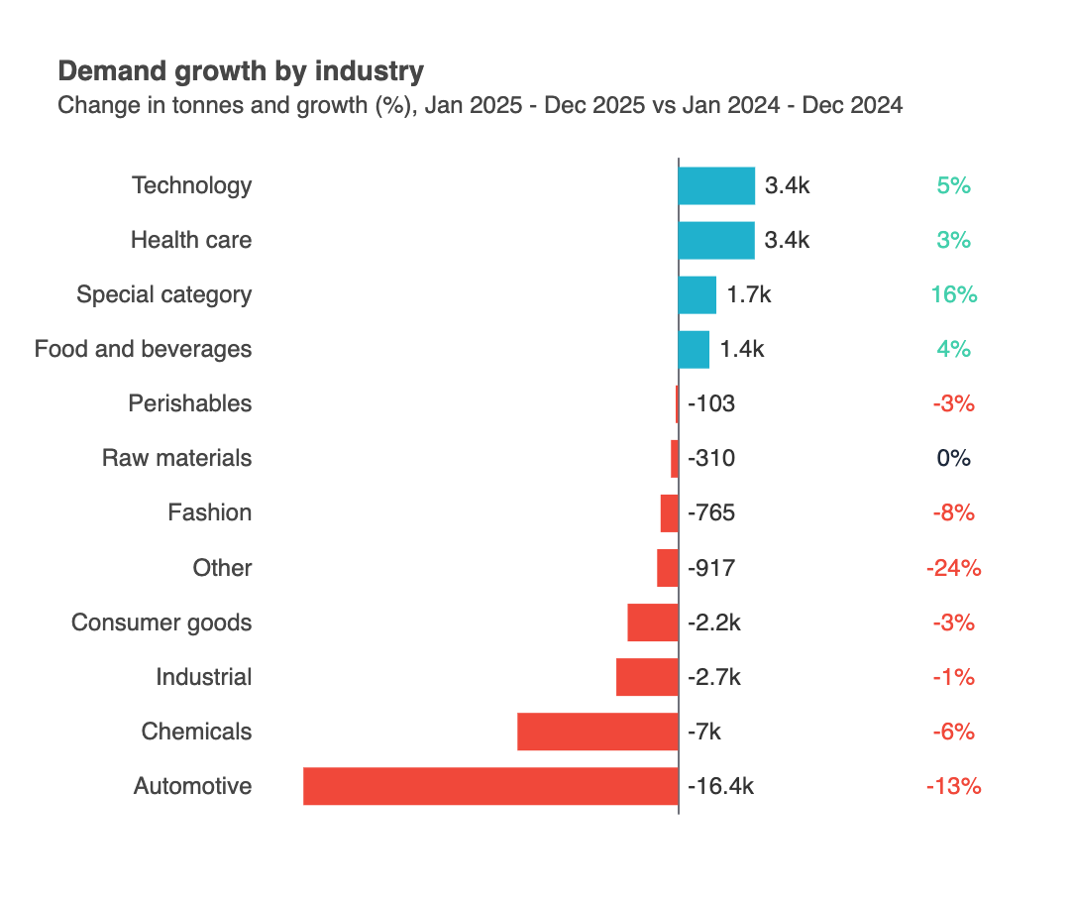
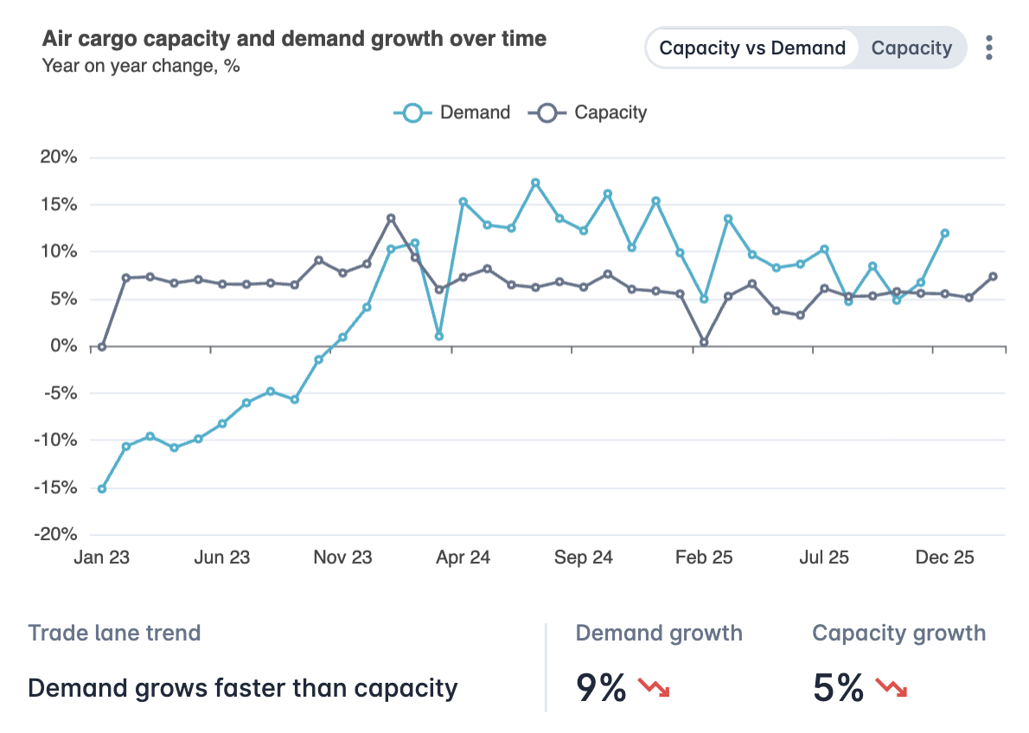
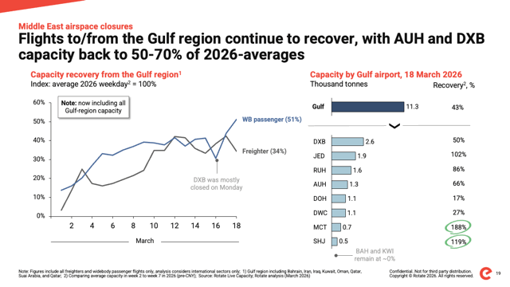
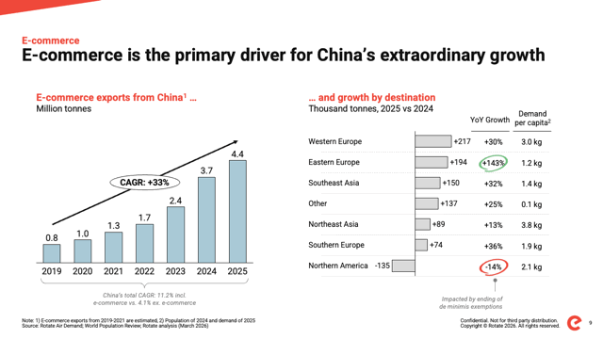
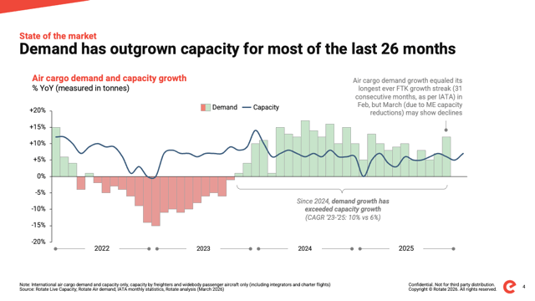
Market data that helps you make better commercial decisions
Steer your sales teams
Improve sourcing decisions
Inform your customers
Target growing verticals incl. pharma, perishables, technology, and e-commerce
Benchmark growth vs. market, spot gaps
Define and refine gateway strategies
Track carriers’ real-time capacity shifts
Compare demand and capacity per lane
Map relevant carriers on new lanes
Identify indirect carriers for deferred options
Share C-level market insights with clients and senior stakeholders
Keep your customers up to date
Create trust with neutral and data-driven insights into key markets

Slide 17

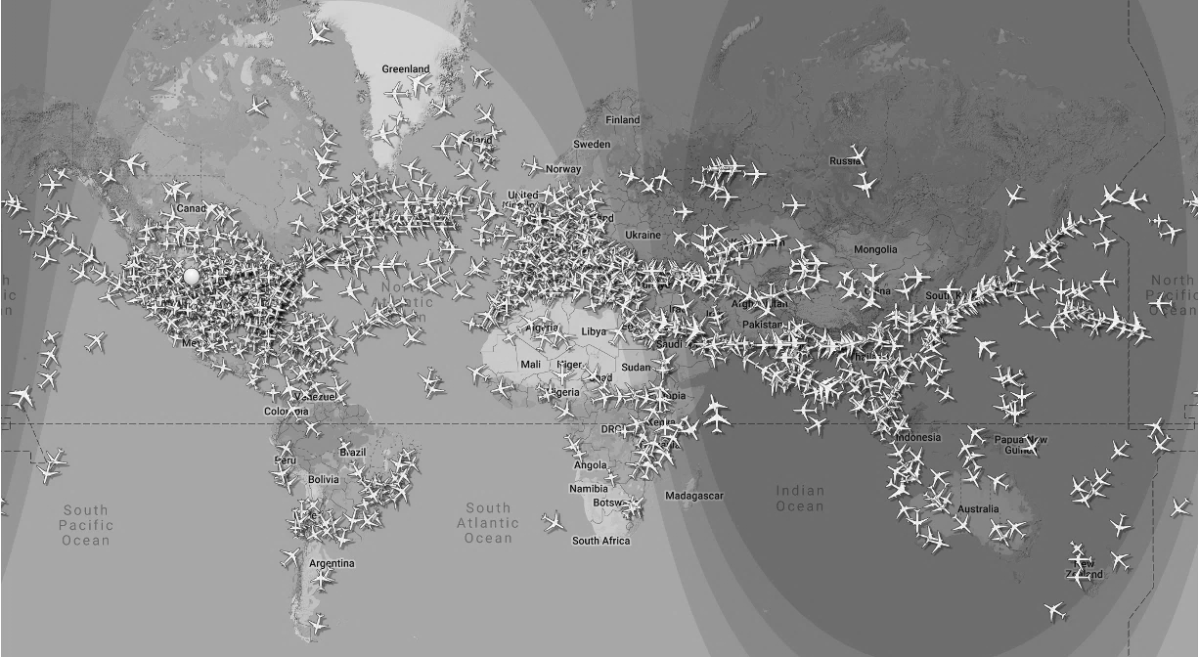



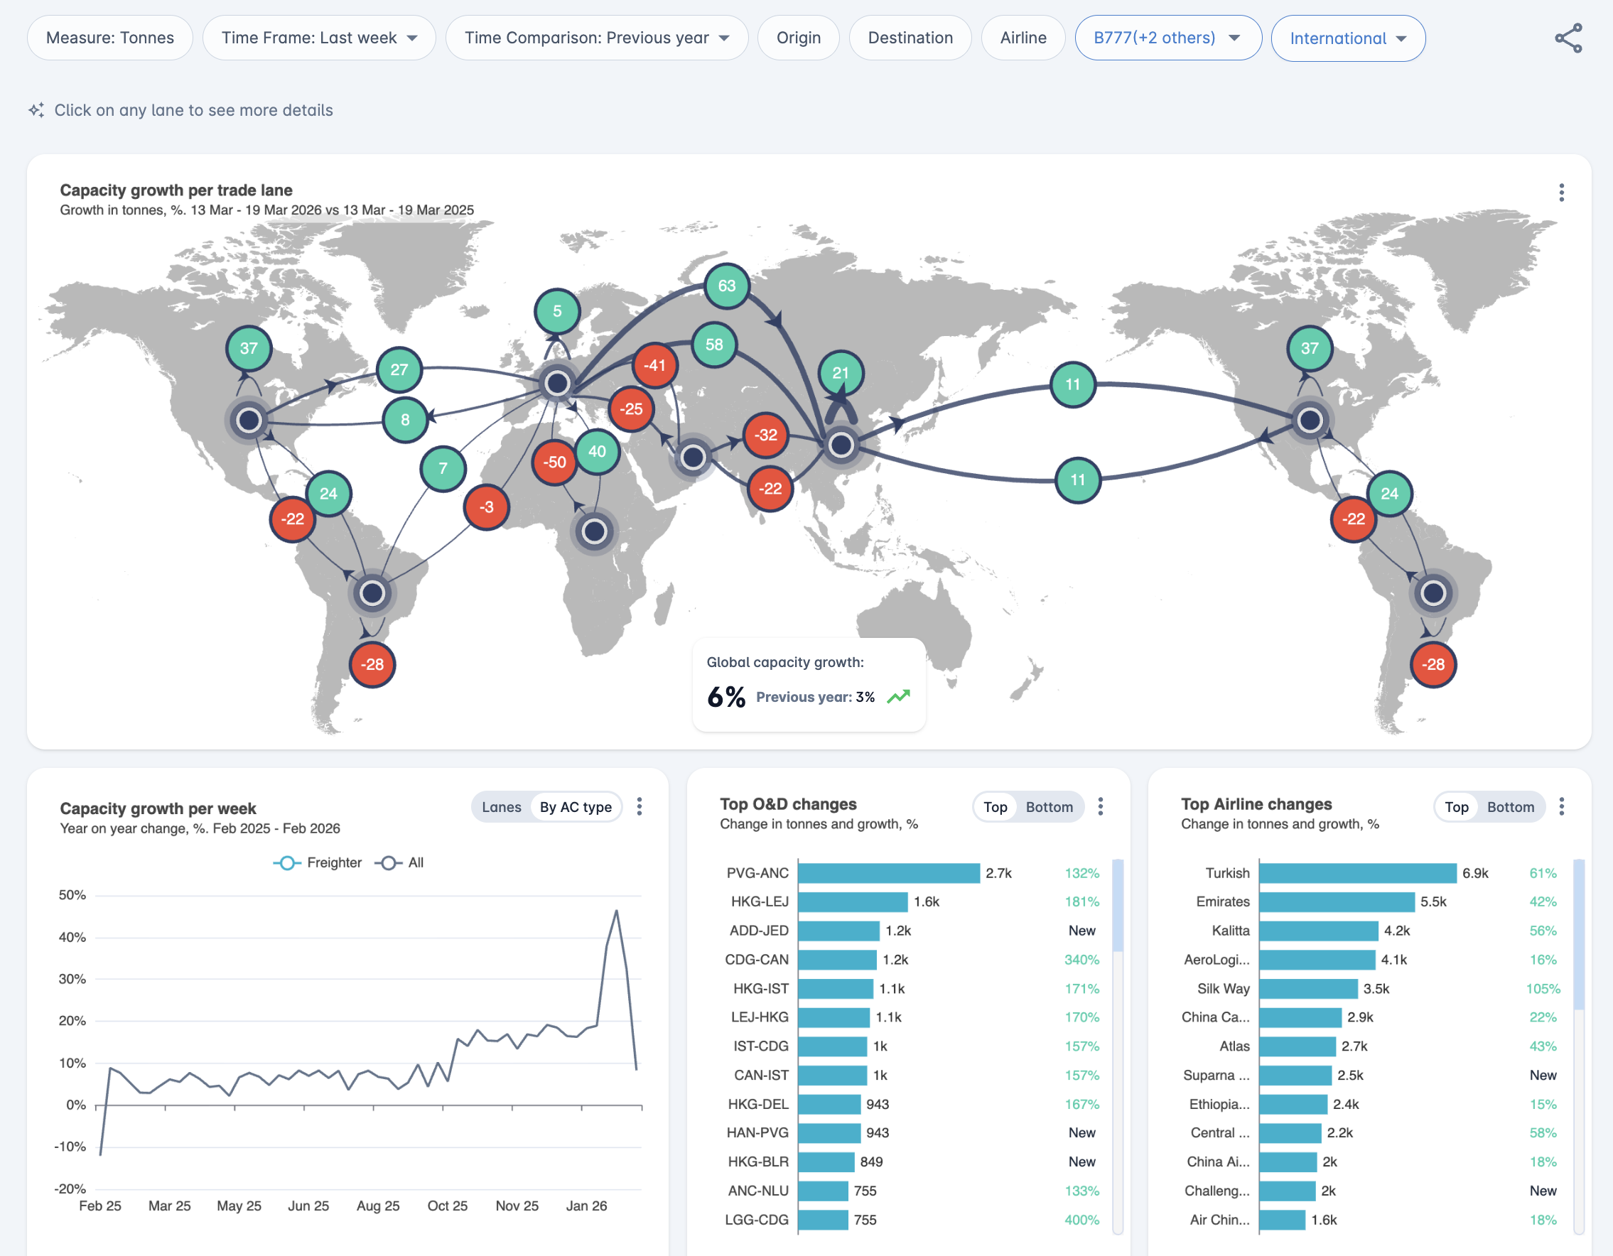

Live Capacity by
Skip for presentation – but keep for distribution
The complete picture on cargo capacity
Real-time capacity Global coverage: >99.9% of flights Hourly updates: historic data available from 2018 100% coverage: all airlines, ODs, lanes, AC types
Direct and indirect connectivity Freighter rotations for all relevant carriers Indirect capacity: indirect routings for any O&D RFS: Including trucking networks
Forward looking capacity 12-month visibility: based on airline schedules Full granularity: by month, week, day, and hour
Coming soon Automated alerts: monitor capacity changes Quality metrics: OTP, transit time, reliability scores Complete integrator and charter carrier capacity
Flights
Schedules
Aircraft details
Proprietary cargo capacity logic
Details on next slide
Confidential. Not for third party distribution.
Copyright © Rotate . All rights reserved.
17
2026

Slide 18

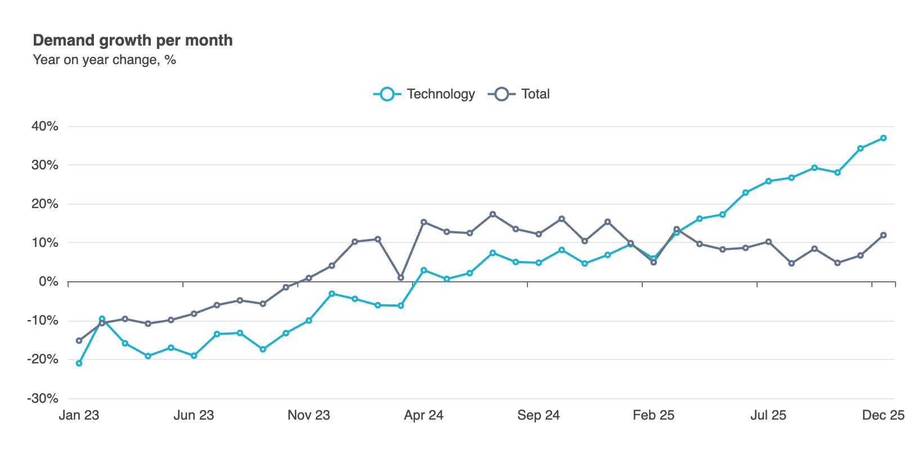
Air Demand by
Skip for presentation – but keep for distribution
Cleaning and triangulation
Standardizing data formats
Error correction
Filling in missing datapoints
E-commerce logic
Vertical mapping
Soon: airport-pair estimation
The most comprehensive view on demand
Global coverage Working towards >99% worldwide coverage No gaps in coverage due to (un)participating airlines Tonnage by country-pair and >5,000 commodities Monthly updates with history from 2010
Unique insights and datapoints E-commerce volume ex-China Air cargo focused verticals Seasonality calendar by product/country
Coming soon 12-month forecast: by month, country, industry Air cargo density and shipper details Real-time demand coverage (to the latest week) Airport-to-airport drill-down Forwarder/airline market share tracking
Triangulation and data cleansing
Details on next slides
Selection of sources
Global demand growth per month
1) Current coverage is 91%, to increase beyond 95% by end of Q1 2026
Confidential. Not for third party distribution.
Copyright © Rotate . All rights reserved.

Slide 19



























































Rotate is a trusted sources across the industry
Skip for presentation – but keep for distribution
Airports / handlers
Government agencies
Investors / lessors
Integrators / forwarders

